Slide 1
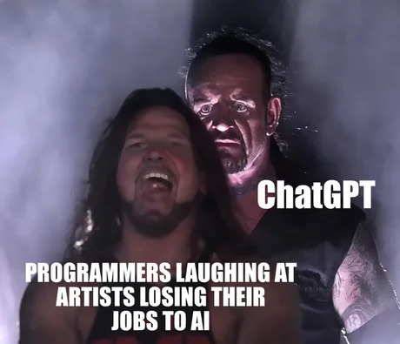
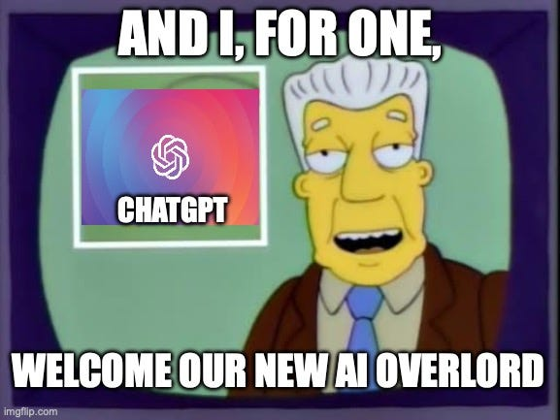
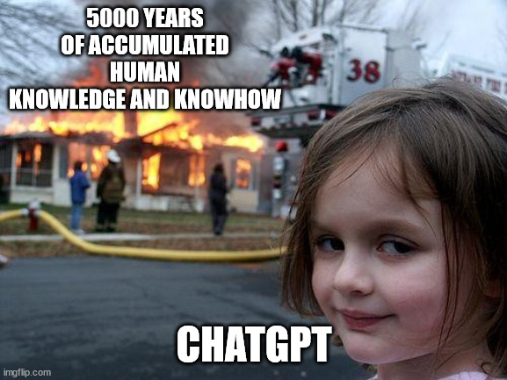

Chatting about ChatGPT Technology created by OpenAI
Presentation by TJ LaGrow
TReNDS Center MLBBQ
03/03/2022
DALL-E 2: “impressionist, chatgpt writing a prompt for itself” Populated: 3/3/23

Slide 2
Overview
Why Should We Be Talking About ChatGPT?
History of Development
Zeitgeist Consequences
Use Cases
Technical Details Of ChatGPT
Overview of GPT-3, ChatGPT, and RLHF
Comparisons to other LLM
Ethical Quandaries As The Technology Progresses
Progress towards AGI?
Discussion about Ownership of Data
How to Best Integrate the Technology into:
Classrooms, Research, Daily life, etc.
1
2
3

Slide 3
History of OpenAI
Non-Profit
[Dec. 2015] Founded by Sam Altman, Greg Brockman, Reid Hoffman, Jessica Livingston, Peter Thiel, Elon Musk, Amazon Web Services (AWS), Infosys, and YC Research with combined $1BB in initial investment.
Yoshua Bengio drew up a list of the "best researchers in the field“ for the founders. OpenAI was able to hire nine of these researches as the first employees.
[Apr. 2016], OpenAI’s Gym, a reinforcement learning research platform, released for public use.
[2017] OpenAI spent $7.9 million on cloud computing compared to DeepMind's total expenses of $442 million.
[2018] Musk resigned his board seat, citing "a potential future conflict [of interest]" due to Tesla's AI development for self-driving cars, but remained a donor.
“Capped” For-Profit Transition
[2019] OpenAI transitioned from non-profit to "capped" for-profit, with the profit capped at 100x any investment.
Microsoft invests $1BB in OpenAI with goal to spend the money in 5 year.
[2020] GPT-3 was announced.
[2021] DALL-E was announced.
[Dec. 2022] ChatGPT was launched to the public, receiving over a million signups within the first five days.
OpenAI was projecting $200 million revenue in 2023 and $1 billion revenue in 2024. Valued at $29BB.
[Jan. 2023] Microsoft announces a $10BB investment.
[Feb. 2023] Microsoft announces integration of ChatGPT into Bing, Edge, and Office 365.
* Most information was scraped from OpenAI’s Wiki Page.
Notes:
The organization stated it would "freely collaborate" with other institutions and researchers by making its patents and research open to the public.
OpenAI researcher Wojciech Zaremba stated that he turned down "borderline crazy" offers of two to three times his market value to join OpenAI instead.
In 2017 OpenAI spent $7.9 million, or a quarter of its functional expenses, on cloud computing alone.^{[21]} In comparison, DeepMind's total expenses in 2017 were $442 million.
In summer 2018, simply training OpenAI's Dota 2 bots required renting 128,000 CPUs and 256 GPUs from Google for multiple weeks.
In 2018, Musk resigned his board seat, citing "a potential future conflict [of interest]" with his role as CEO of Tesla due to Tesla's AI development for self-driving cars, but remained a donor.
According to OpenAI, the capped-profit model allows OpenAI LP to legally attract investment from venture funds, and in addition, to grant employees stakes in the company, the goal being that they can say "I'm going to OpenAI, but in the long term it's not going to be disadvantageous to us as a family.“
Many top researchers work for Google Brain, DeepMind, or Facebook, which offer stock options that a nonprofit would be unable to.^{[25]} Prior to the transition, public disclosure of the compensation of top employees at OpenAI was legally required.
The company then distributed equity to its employees and partnered with Microsoft and Matthew Brown Companies,^{[27]} who announced an investment package of $1 billion into the company.
The transition from a nonprofit to a capped-profit company was viewed with skepticism by Oren Etzioni of the nonprofit Allen Institute for AI, who agreed that wooing top researchers to a nonprofit is difficult, but stated "I disagree with the notion that a nonprofit can't compete" and pointed to successful low-budget projects by OpenAI and others. "If bigger and better funded was always better, then IBM would still be number one.“

Slide 4
History of ChatGPT
Date | Milestone
Jun. 2018 | GPT-1 announced on the OpenAI blog.
Feb. 2019 | GPT-2 announced on the OpenAI blog.
May 2020 | Initial GPT-3 preprint paper published to arXiv.
Jun. 2020 | GPT-3 API private beta.
Sep. 2020 | GPT-3 licensed to Microsoft.
Nov. 2021 | GPT-3 API opened to the public.
Jan. 2022 | InstructGPT released as text-davinci-002, now known as GPT-3.5. InstructGPT preprint paper Mar/2022.
Jul. 2022 | Exploring data-optimal models with FIM, paper on arXiv.
Sep. 2022 | GPT-3 model pricing cut by 66% for davinci model.
Sep. 2022 | Whisper (speech recognition) announced on the OpenAI blog.
Nov. 2022 | GPT-3.5 expanded to text-davinci-003, announced via email:
 | 1. Higher quality writing.
 | 2. Handles more complex instructions.
 | 3. Better at longer form content generation.
Nov. 2022 | ChatGPT announced on the OpenAI blog.
Feb. 2023 | ChatGPT hits 100 million monthly active unique users (via UBS report).
* Colored text associated with a hyperlink source

Slide 5
How Popular is ChatGPT?
GPT-3 was outputting 3.1 million wpm in Mar. 2021 (“We currently generate an average of 4.5 billion words per day, and continue to scale production traffic.”) (OpenAI blog, March 2021)
GPT-3 had 1 million users about a year later in Jun. 2022 (“more than 1 million signups! took gpt-3 ~24 months to get there”) (Sam Altman tweet, 22/Jun/2022)
ChatGPT had 100 million monthly users in Jan. 2023 (UBS).
With crude math, ChatGPT may be currently outputting 310 million wpm.
Twitter users output 350,000 tweets sent per minute (2022), at 8 words (34 chars) average, a total of 2.8 million wpm.
This, in Jan. 2023, ChatGPT is probably outputting at least 110x the equivalent volume of Tweets by human Twitter users every day.
A study conducted by Google Books found that there have been 129,864,880 books published since the invention of Gutenberg’s printing press in 1440. At an average of 50,000 words per book, that is about 6.5T words total.
So, in Jan. 2023, ChatGPT is probably outputting at least the equivalent of the entire printed works of humanity every 14 days.
* Source for rough calculation: https://lifearchitect.ai/chatgpt/

Slide 6
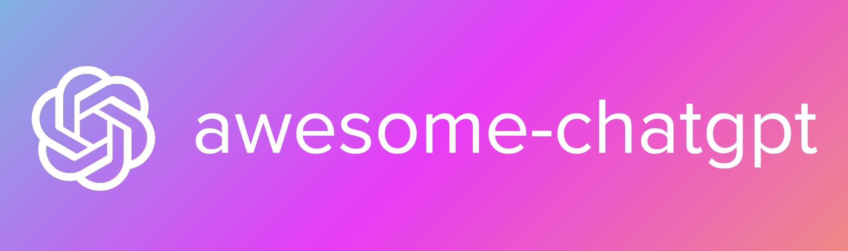
Uses of ChatGPT?
Link to a comprehensive list: https://github.com/saharmor/awesome-chatgpt

Slide 7
Achievements by ChatGPT
Field | Achievement | Result | Outperforms human avg? | Engine | Testing date | Peer- reviewed? | Paper/ link | Extract
IQ (fluid/aptitude) | ChatGPT outperforms college students on the Raven's Progressive Matrices aptitude test. | >98% | Yes | text-davinci-003 | 19/Dec/2022 | Yes | 🔗 | More info at: https://lifearchitect.ai/ravens/
AWS certificate | ChatGPT would pass the AWS Certified Cloud Practitioner exam. | 80% | Yes | ChatGPT | 8/Dec/2022 | No | 🔗 | "Final score: 800/1000; a pass is 720"
IQ (verbal only) | ChatGPT scores IQ=147, 99.9th %ile. | >99.9% | Yes | ChatGPT | 6/Dec/2022 | No | 🔗 | "Psychology Today Verbal-Linguistic Intelligence IQ Test, it gets a score of 147!"
SAT exam | ChatGPT scores 1020/1600 on SAT exam. | 52% | Yes | ChatGPT | 2/Dec/2022 | No | 🔗 | "According to collegeboard, a 1020/1600 score is ~52nd percentile."
General knowledge | GPT-3 would beat IBM Watson on Jeopardy! questions. | 100% | Yes | davinci | 20/Sep/2021 | No | 🔗 | Watson scored 88%, GPT-3 scored 100%.
IQ (Binet-Simon Scale, verbal only) | GPT-3 scores in 99.9th %ile (estimate only). | 99.9% | Yes | davinci | 11/May/2021 | No | 🔗 | "As of 2021, I expect that it would not be simple to assess the intelligence of an AI using current IQ instrument design... some subtests where the AI would be easily in the top 0.01% of the world population (processing speed, memory), while other subtests may be far lower."
General knowledge | GPT-3 outperforms average humans on trivia. | 73% | Yes | davinci | 12/Mar/2021 | No | 🔗 | "GPT-3 got 73% of 156 trivia questions correct. This compares favorably to the 52% user average."
Reasoning | GPT-3 would pass the SAT Analogies subsection. | 65.2% | Yes | davinci | 28/May/2020 | Yes | 🔗 | "GPT-3 achieves 65.2% in the few-shot setting... average score among college applicants was 57% (random guessing yields 20%)."
* Source for timeline spreadsheet.

Slide 8
Achievements by ChatGPT
Field | Achievement | Result | Outperforms human avg? | Engine | Testing date | Peer- reviewed? | Paper/ link | Extract
Cover of TIME magazine | ChatGPT made the 27/Feb/2023 cover of TIME magazine | - | Yes | ChatGPT | 27/Feb/2023 | No | 🔗
Software dev job | ChatGPT would be hired as L3 Software Developer at Google: the role pays $183,000/year. | - | Yes | ChatGPT | 31/Jan/2023 | No | 🔗 | https://www.pcmag.com/news/chatgpt-passes-google-coding-interview-for-level-3-engineer-with-183k-salary https://www.cnbc.com/2023/01/31/google-testing-chatgpt-like-chatbot-apprentice-bard-with-employees.html "ChatGPT gets hired at L3 when interviewed for a coding position"
Jurisprudence/ legal rulings | ChatGPT helps a judge with a verdict (Colombia). | - | - | ChatGPT | 31/Jan/2023 | No | 🔗 | English: https://interestingengineering.com/innovation/chatgpt-makes-humane-decision-columbia Spanish: https://www.bluradio.com/judicial/sentencia-la-tome-yo-chatgpt-respaldo-argumentacion-juez-de-cartagena-uso-inteligencia-artificial-pr30 "On January 31, the first labor court of Cartagena resolved a guardianship action with the help of the famous artificial intelligence known as ChatGPT, arguing that it applied Law 2213 of 2022, which says that in certain cases these virtual tools can be used."
Politics | ChatGPT writes several Bills (USA). | - | - | ChatGPT | 26/Jan/2023 | Yes | 🔗 | Regulate ChatGPT: https://malegislature.gov/Bills/193/SD1827 Mental health & ChatGPT: https://malegislature.gov/Bills/193/HD676
MBA | ChatGPT would pass an MBA degree exam at Wharton (UPenn). | B/B- | Yes | ChatGPT | 22/Jan/2023 | Yes | 🔗 | "Considering this performance, ChatGPT would have received a B to B- grade on the exam."
Accounting | GPT-3.5 would pass the US CPA exam. | 57.6% | Yes | text-davinci-003 | 11/Jan/2023 | Yes | 🔗 | "the model answers 57.6% of questions correctly"
Legal | GPT-3.5 would pass the bar in the US. | 50.3% | Yes | text-davinci-003 | 29/Dec/2022 | Yes | 🔗 | "GPT-3.5 achieves a headline correct rate of 50.3% on a complete NCBE MBE practice exam"
Medical | ChatGPT would pass the United States Medical Licensing Exam (USMLE). | >60% | Yes | ChatGPT | 20/Dec/2022 | Yes | 🔗 | "ChatGPT performed at >50% accuracy across all examinations, exceeding 60% in most analyses. The USMLE pass threshold, while varying by year, is approximately 60%. Therefore, ChatGPT is now comfortably within the passing range."
* Source for timeline spreadsheet.

Slide 9
What is a Language Model?
Probability distribution over strings of text
How likely is a given string (observation) in a given “language”
For example, consider probabilities for the following four strings
English: P1 > P2 > P3 > P4
P1 = P(“a quick brown dog”)
P2 = P(“dog quick a brown”)
P3 = P(‘un chien quick brown”)
P4 = P(“un chien brun rapide”)
…depends on what “language” we are modeling
In most of IR we will have P1 = P2
For some application we will want P3 to be highly probable
* Source for rough calculation: https://lifearchitect.ai/chatgpt/

Slide 10
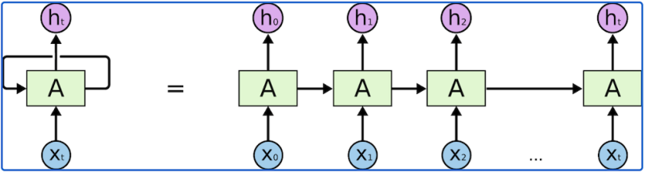

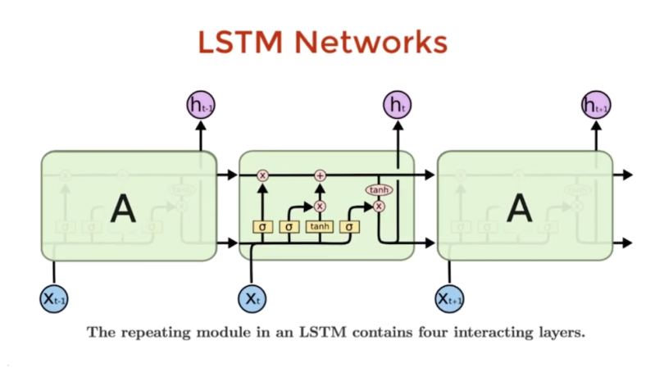
What is a Language Model?
RNN
Transformer Block
* Source for architecture diagrams: https://builtin.com/artificial-intelligence/transformer-neural-network

Slide 11
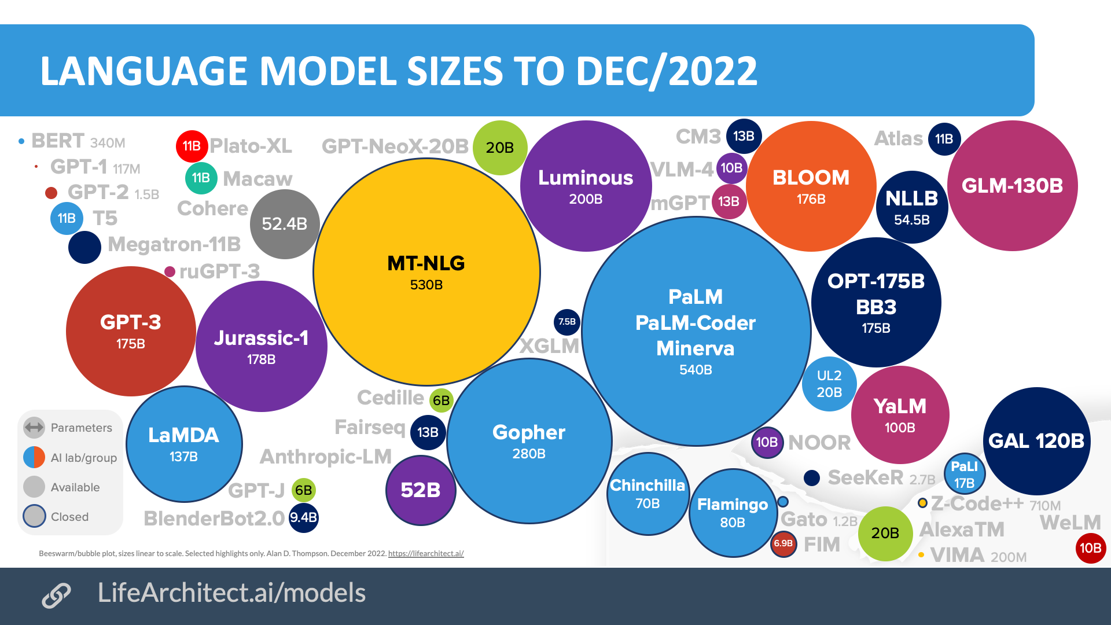
Technical Details of ChatGPT
* Source for LL Model Sizes.

Slide 12
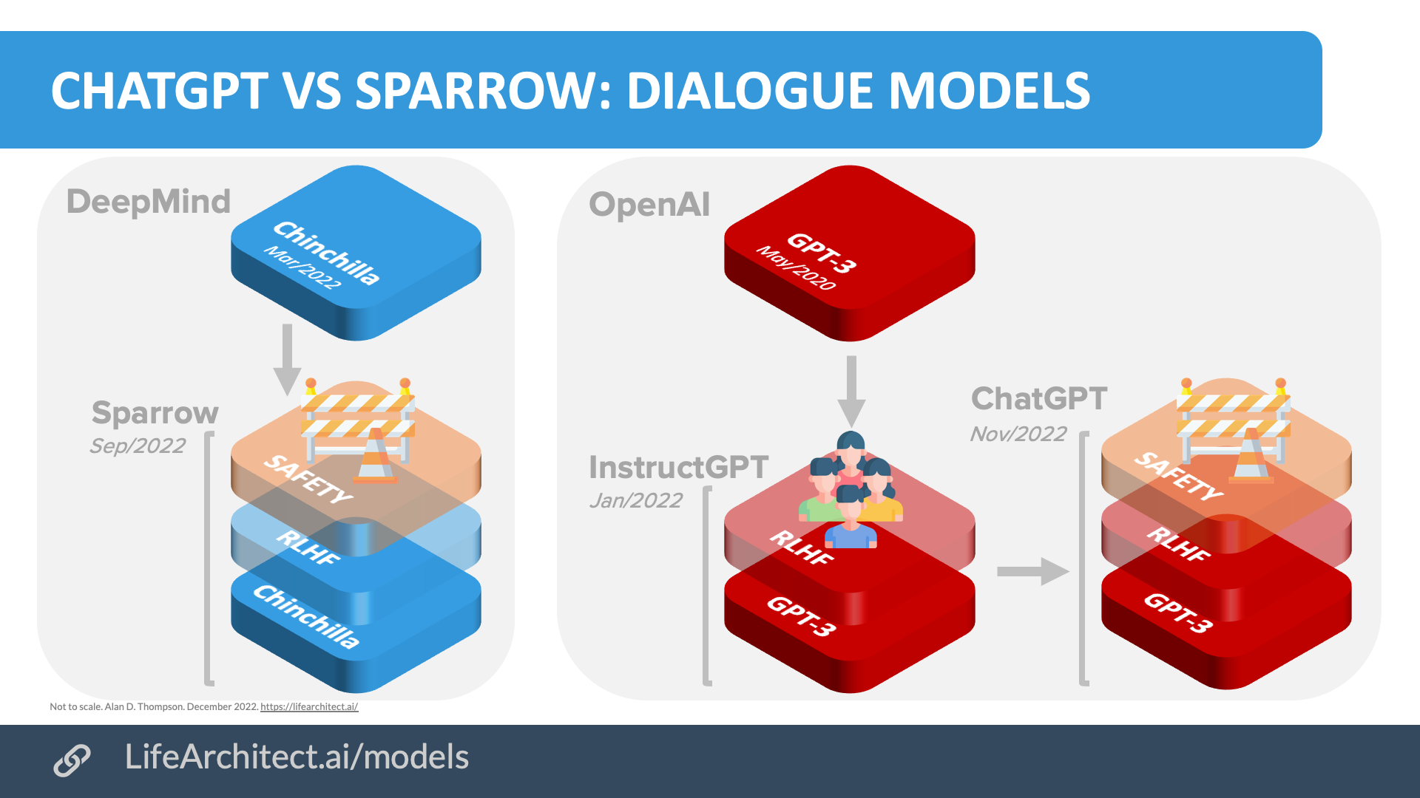
Technical Details of ChatGPT
* Source for LL Model Sizes.

Slide 13
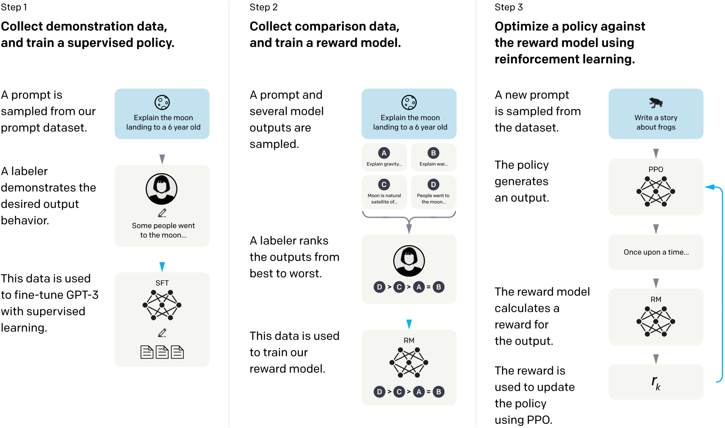
Technical Details of ChatGPT
* Ouyang, Long, et al. "Training language models to follow instructions with human feedback." arXiv preprint arXiv:2203.02155 (2022).

Slide 14
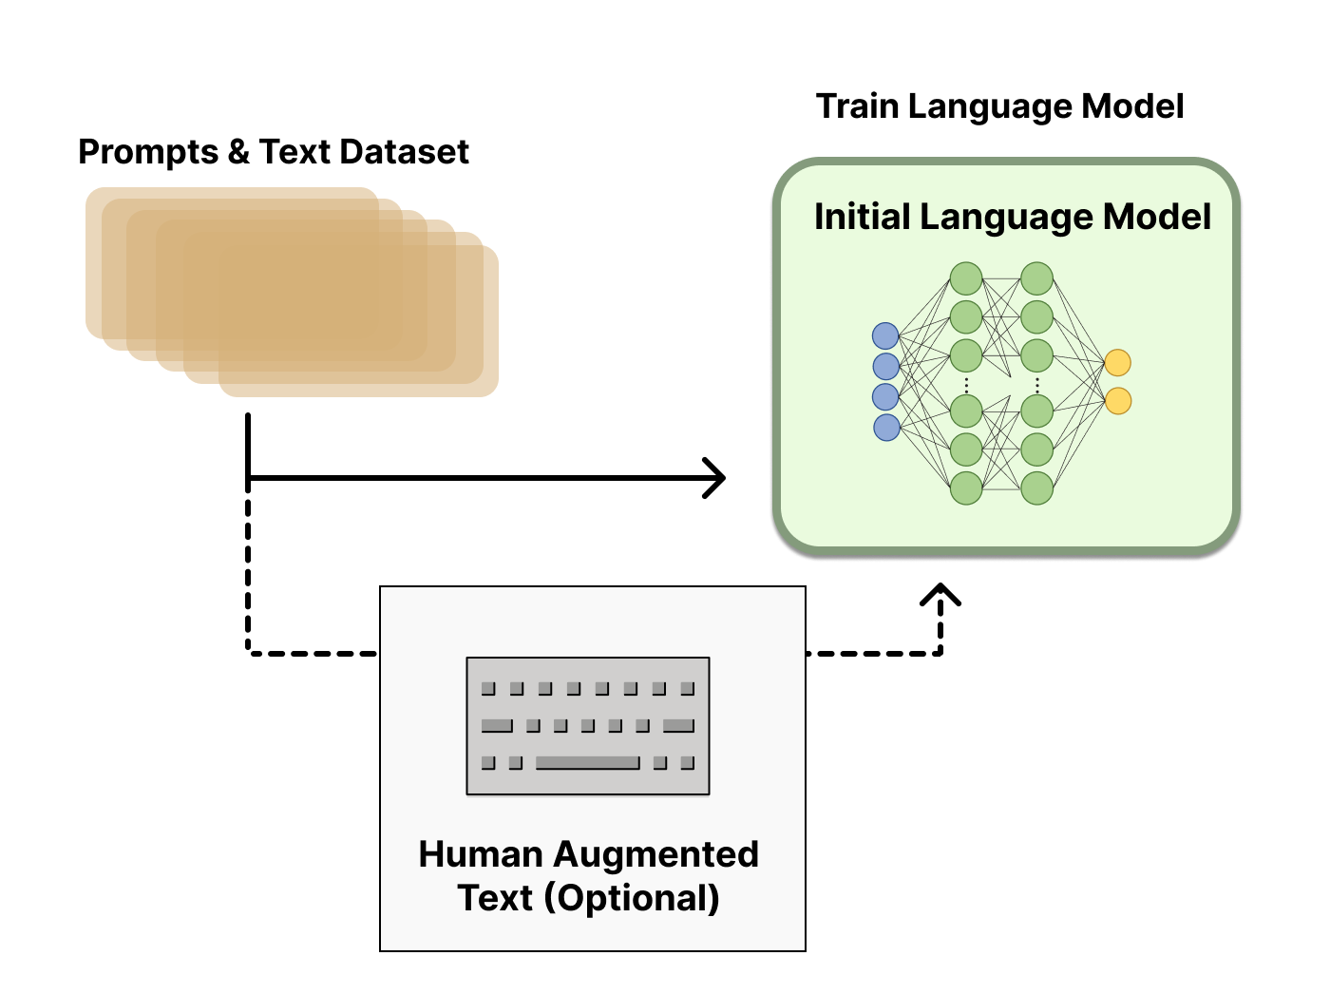
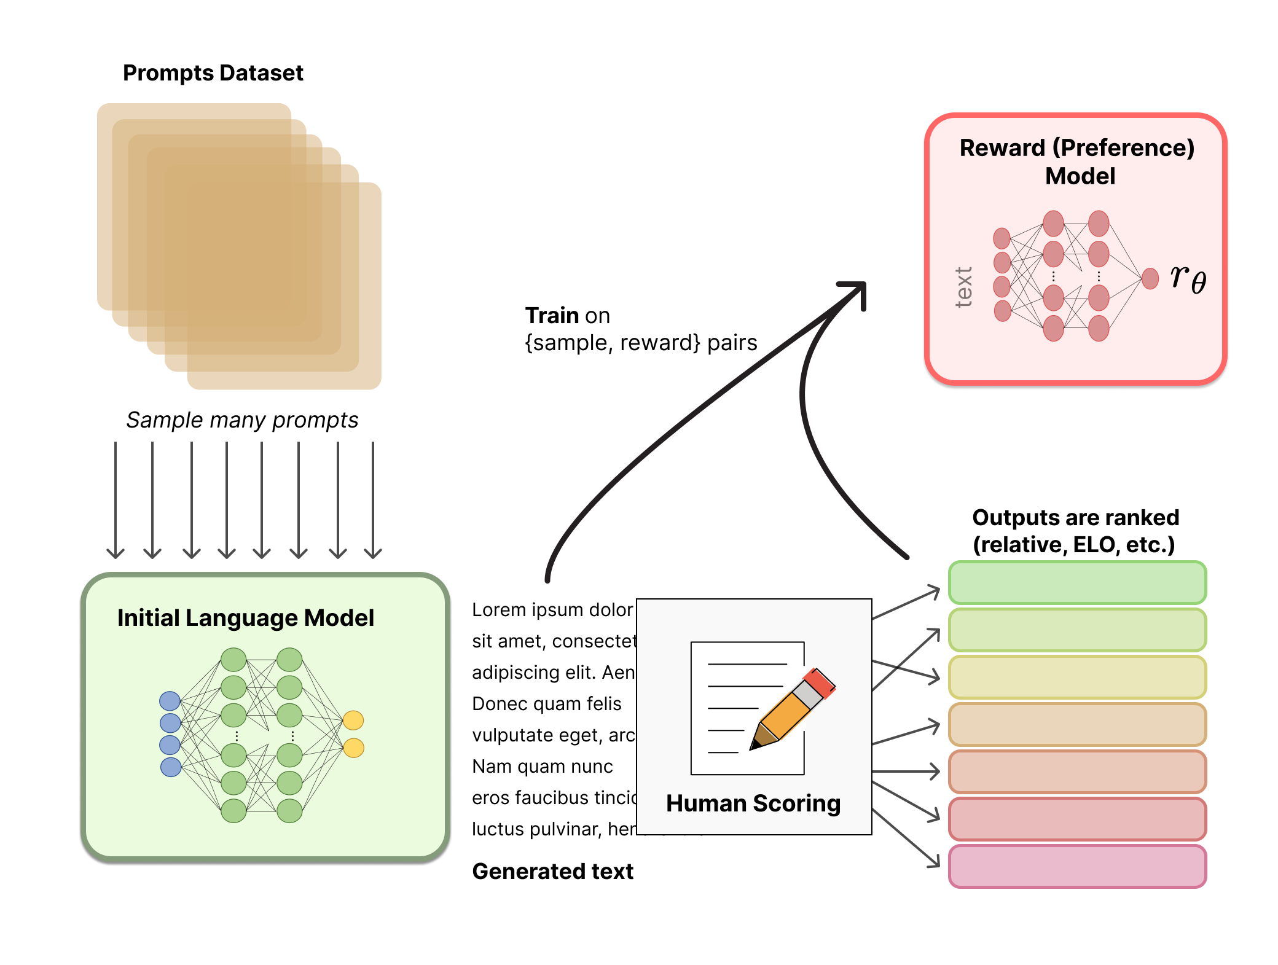
Technical Details of ChatGPT

Slide 15
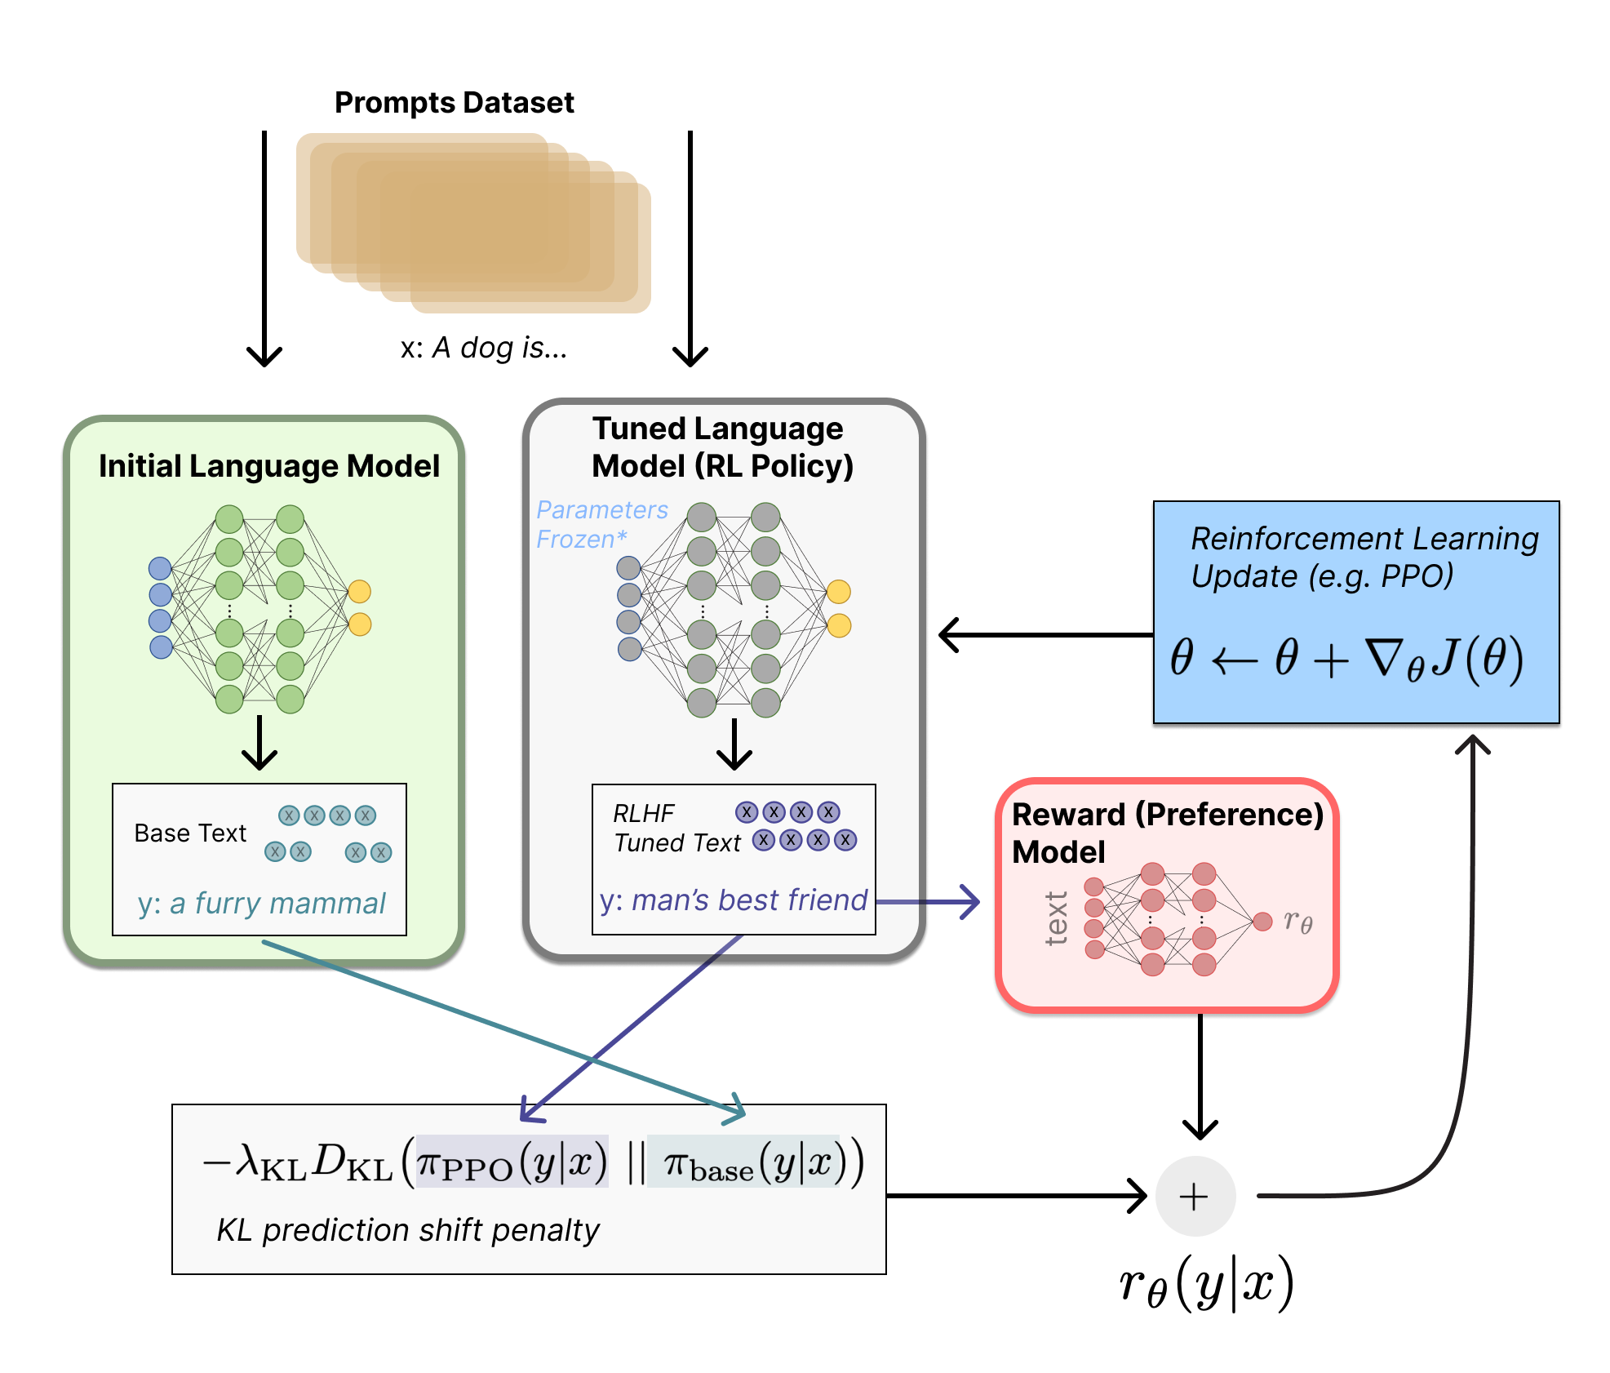
Technical Details of ChatGPT
Formulation of RL Problem
The policy is a language model that takes in a prompt and returns a sequence of text (or just probability distributions over text)
The action space of this policy is all the tokens corresponding to the vocabulary of the language model.
The reward function is a combination of the preference model and a constraint on policy shift
Fine Tuning (update) is done with a PPO algorithm with use of KL Divergence as a loss function based on the probability distribution output.
Notes:
penalty has been designed as a scaled version of the Kullback–Leibler (KL) divergence between these sequences of distributions over tokens, �KLrKL​. The KL divergence term penalizes the RL policy from moving substantially away from the initial pretrained model with each training batch, which can be useful to make sure the model outputs reasonably coherent text snippets. Without this penalty the optimization can start to generate text that is gibberish but fools the reward model to give a high reward. In practice, the KL divergence is approximated via sampling from both distributions (explained by John Schulman here). The final reward sent to the RL update rule is �=��−��KLr=rθ​−λrKL​.

Slide 16
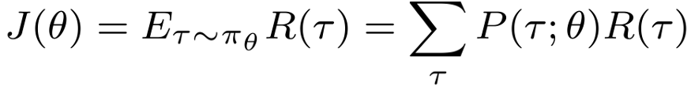
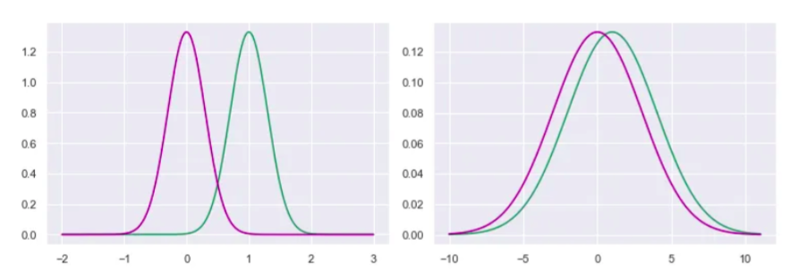
Technical Details of ChatGPT
Fine Tuning (update) is done with a PPO algorithm with use of KL Divergence as a loss function based on the probability distribution output.
Vanilla Policy Gradient Objective Function
Notes:
penalty has been designed as a scaled version of the Kullback–Leibler (KL) divergence between these sequences of distributions over tokens, �KLrKL​. The KL divergence term penalizes the RL policy from moving substantially away from the initial pretrained model with each training batch, which can be useful to make sure the model outputs reasonably coherent text snippets. Without this penalty the optimization can start to generate text that is gibberish but fools the reward model to give a high reward. In practice, the KL divergence is approximated via sampling from both distributions (explained by John Schulman here). The final reward sent to the RL update rule is �=��−��KLr=rθ​−λrKL​.

Slide 17
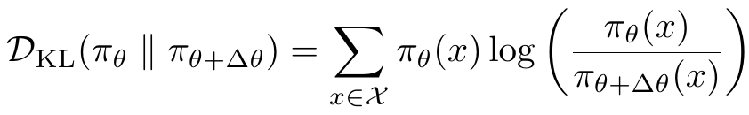
Technical Details of ChatGPT
Fine Tuning (update) is done with a PPO algorithm with use of KL Divergence as a loss function based on the probability distribution output.
Vanilla Policy Gradient Objective Function
KL-divergence
PPO – Variant w/ Adaptive KL Penalty
Notes:
penalty has been designed as a scaled version of the Kullback–Leibler (KL) divergence between these sequences of distributions over tokens, �KLrKL​. The KL divergence term penalizes the RL policy from moving substantially away from the initial pretrained model with each training batch, which can be useful to make sure the model outputs reasonably coherent text snippets. Without this penalty the optimization can start to generate text that is gibberish but fools the reward model to give a high reward. In practice, the KL divergence is approximated via sampling from both distributions (explained by John Schulman here). The final reward sent to the RL update rule is �=��−��KLr=rθ​−λrKL​.

Slide 18
Technical Details of ChatGPT
Train ChatGPT Yourself!
To get to GPT-3 175B davinci model standards, you’ll need the following:
Training hardware: Access to a supercomputer with ~10,000 GPUs and ~285,000 CPU cores. If you can’t buy it, you could do as OpenAI did with Microsoft, spending their $1 billion dollars (USD) to rent it.
Staffing: For training, you’ll need access to the smartest PhD-level data scientists in the world. OpenAI paid their Chief Scientist Ilya Sutskever $1.9 million dollars per year (USD) in 2016, and they have a team of 120 people. Perhaps budget >$200 million for staffing the first year.
Time (data collection): EleutherAI took a solid 12-18 months to agree on, collect, clean, and prepare data for the The Pile. Note that if The Pile is only ~400B tokens, you need to somehow find The Pile-quality data at least four times to even make something similar to the new efficiency standard, DeepMind’s Chinchilla 70B (1400B tokens), and you might want to aim for a few TB now to outperform GPT-3.
Time (training): Expect a model to take 9-12 months of training, and that’s if everything goes perfectly. You may need to run it several times, and you may need to train several models in parallel. Things do go wrong, and they can completely mess up the results (see the GPT-3 paper, China’s GLM-130B and Meta AI’s OPT-175B logbook).
Inference: Fairly beefy computers, plus devops staffing resources, but this is the least of your worries. Good luck!
* Source for calculation: https://lifearchitect.ai/chatgpt/

Slide 19
Ethical Quandaries with ChatGPT
Labeling data
OpenAI used outsourced Kenyan workers earning less than $2 per hour to label toxic content.
The outsourced laborers were exposed to such toxic and dangerous content that they described the experience as "torture".
Jailbreaking
ChatGPT attempts to reject prompts that may violate its content policy. However, with prompt engineering you can bypass these safeguard.
In early December 2022, testers successfully tricked ChatGPT into giving instructions for how to create a Molotov cocktail or a nuclear bomb, or into generating arguments in the style of a neo-Nazi.
Accusations of bias
Some accused ChatGPT of having a bias towards liberal perspectives, including having been configured to avoid responses that are "partisan, biased or political in nature", and making responses in support of issues that have been objected to by conservatives.
Notes:
OpenAI published a blog post that acknowledged plans to, in the future, allow ChatGPT to create "outputs that other people (ourselves included) may strongly disagree with". It also contained information on the recommendations it had issued to human reviewers on how to handle controversial subjects, including that the AI should "offer to describe some viewpoints of people and movements", and not provide an argument "from its own voice" in favor of "inflammatory or dangerous" topics (although it may still "describe arguments from historical people and movements"), nor "affiliate with one side" or "judge one group as good or bad".

Slide 20
Ethical Quandaries with ChatGPT
Should we cite ChatGPT as an author if we use the software for writing?
Does this apply to Google Search or Adobe Illustrator for paper content generation?
Are we getting closer to AGI?
Shallow/Narrow AI vs. AGI
Steve Wozniak’s test of AGI: can walk into a strange house, navigate available tools, and make a cup of coffee from scratch
What does the public trust or “buy-in” look like over the next several years?
Google search took several years for adoption
Wikipedia was not trusted as a valuable source of information, now is the gold standard
Should LLMs or Machine Learning be a required for Computer Science degrees (undergrad and graduate students)?
With the innovation, are we failing students if we do not cover them in some capacity for use?
“Jobs will shift - lawyers will be replace with lawyers who can use ChatGPT.” – John Oliver, 2/26/23

Slide 21
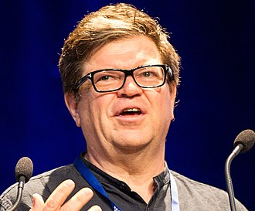
Competing LLMs
Gopher, Chichilla (Deepmind)
Switch transformer, GLAM, PALM, Lamba, T5, MT5 (Google)
OPT, Fairseq Dense (Meta)
GPT-3 versions such as GPT-Neo, GPT-J, & GPT-NeoX (Open-AI)
Ernie 3.0 (Baidu)
Jurassic (AI21Labs)
Exaone (LG)
Pangu Alpha (Huawei)
Roberta, XML-Roberta, Deberta
DistilBert
XLNet
Naver, SearchGPT (South Korea, announced 2023)
Yandex (Russia, announced 2023)
Meta's Yann LeCun, who has called ChatGPT "well engineered" but "not particularly innovative.“ Meta released LLaMA Feb. 2023.

Slide 22
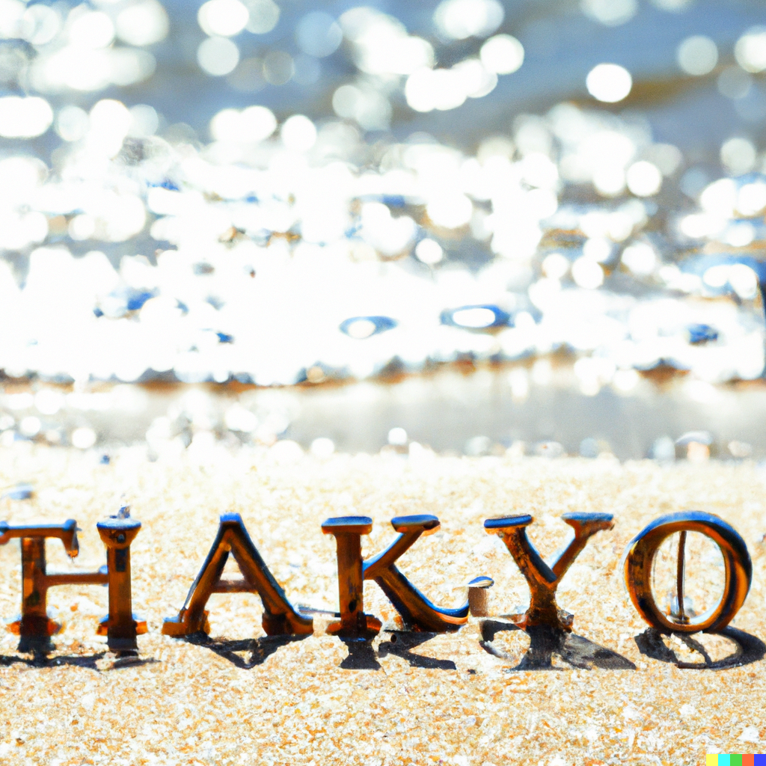
DALL-E 2 Prompt: “bubble letters of "thank you" on a sparkling beach”

